Slide 1
Haywood County
Fiscal Year 2015 – 2016
Proposed Budget
May 18, 2015

Slide 2
budget process & development
Planning Process officially began in December with Work Session and Budget Evaluation
Board of Commissioners Budget Work Session in February
Department Head Kick-off meeting and individual meetings with all Departments/Offices/ Agencies
Budget Work Session with presentations from School System and Haywood Community College

Slide 3
DEMOGRAPHICS AND ECONOMIC INDICATORS
Post-retirees (65 and over) continues to be our biggest area of population growth, but number of children is growing too
Need for popular quality of life services (Senior Services, Libraries, Recreation) will continue
Economy is recovering
Small increases in private sector employment over prior year
Building permits increased
Home sales improving over prior year
Home sale values are up

Slide 4
GOALS FIXED BY THE BUDGET
Provides increased funding to the Public Schools
Provides a contingency to cover the expense of Charter Schools
Provides increased funding to the Community College
Continues planning and begins construction of a new EMS and Emergency Management Facility
Increases the salaries of Haywood County employees to make them more competitive
Provides adequate Maintenance on the Facilities owned by the County
Takes into account the review of the Work Force in Public Safety areas, and fixes temporary labor usage in Detention
Reviews salaries and gave raises to the lowest paid workers first. All full time employees will make at least $9.69 per hour

Slide 5
GOALS FIXED BY THE BUDGET
Provides safe, convenient service in Solid Waste and complies with all regulations; specific projects include the Francis Farm remediation and upgrades to convenience centers
Maintains current levels of service to the Public including maintenance of current operations schedule
Begins planning, needs assessment and subsequent construction of a new animal services facility
Maintains funding to community clubs
Maintains the Wellness Center and health benefits for employees
Increases 401K contribution; adds a 2% COLA
Continues merit pay 0-2%; maintains holiday and longevity pay
Maintains adequate contingency

Slide 6
Overview
Tax rate proposed increased to 56.61 cents per $100 valuation.
General Fund expenditures proposed to increase by $3,870,995 (5.60%)

Slide 8
Where does the money come from?

Slide 9
REVENUES
County budget is a mix of revenues from Federal, State and local sources
This includes taxes, permits, fees and inter-governmental revenues
Some revenues are restricted and can only be spent on certain items such as monies for the WIC program or subsidized child care

Slide 10
REVENUES
AD VALOREM PROPERTY TAXES
Projected growth in Ad Valorem tax base -
approximately $963,683 without tax raise
Increase in delinquent collections, particularly MV taxes.
NC Tax and Tag is working
Prior year taxes must be paid before tag issues.
One cent equivalent on tax rate = $714,000

Slide 11
REVENUES
Local Option Sales Taxes
Sales tax revenue reflects a 3.6% increase over prior year budget
Portion of sales taxes earmarked for public school capital - $2,674,527
Portion of sales taxes earmarked for community college capital - $1,601,505
Portion for County projects - $8,567,955
Increase in sales tax available for County use - $297,729

Slide 12
SALES TAX HISTORY & PROJECTIONS

Slide 13
Why increase Ad Valorem Taxes? Revenue Picture
County money to cover increased expenditures
Ad Valorem - $963,683
Sales Tax - $297,729
Unrestricted inter-governmental – (55%) – approximately $145,427
Increase in sales and services - $383,899
Total new dollars to use from above: $1,790,738
Restricted inter-governmental revenues
cannot be used for all needed expenditures

Slide 14
Where does the money go?

Slide 15
EXPENDITURES
In each functional area presented, some of the large items requiring additional County dollars will be highlighted in green.
Trends across areas include the needs for increased
Vehicles
Technology
Facility repair
Special attention to a salary review will be done towards the end

Slide 16
education
Recommended budget is $17,744,607
Areas needing additional Revenue to meet need:
Haywood County Schools Operating – Increase of $292,890
Haywood County Community College Operating – Increase of $43,222

Slide 17
General Government
Anticipated increase in Retiree Healthcare Insurance
Coverage – $100,000
Elections up due to additional primary – $48,927
Real property appraisal - Reval Commercial Appraiser - $28,500
Real Property Appraisal software and updates - $66,000
Land Records printer/plotter $9,750
Legal to $171,925, increase of $67,000 (has averaged $213,000/yr for last 5 years).
Overall budget of $5,566,171, increase of $603,117 (12.15%)

Slide 18
Central Services
Several new projects –
County Garage - $15,037
HVAC Canton Library - $30,000
HVAC Waynesville Library - $36,000
Fines Creek main building and old gymnasium roof - $100,000
Increased Maintenance vehicle garage - $30,000
Repairs increased - $100,000
IT – KRONOS - $35,350
Animal Services software and technology- $30,000
Budget defers some repair and maintenance
if not a safety issue
Overall budget $3,498,550, increase of $515,648 (17.29%)

Slide 19
Public Safety
Many things going on:
Animal Services
Need for new vehicle - $24,000
Current vehicle – 2004 F-150 4-wheel drive
Mileage: 167,723
EOC/911
Remodeling Sheriff’s Office into new 911 communication center
using grant funds
Emergency Management
Need for new vehicle - $27,083
Current vehicle – 2004 Ford Expedition 4x4
Mileage – 150,433

Slide 20
Public Safety
EMS –
Over 10,000 calls
5 ambulances greater than 140,000 miles; 2 are more than 7 years old
Older vehicles are in need of more repairs
Recommend remounting 2 ambulances - $200,000
Buy 1 new ambulance with bariatric lift - additional $30,000
Need to monitor use of temporary labor for future purposes

Slide 21
Public Safety
Recommendation – temporary/part-time into four full time permanent detention officers - $192,000
Replacement of 2 Sheriff patrol vehicles and 1 EMS ambulance. Will need to consider more at mid year
Overall budget of $14,593,376, increase of $1,062,022 (7.85%)

Slide 22
Detention
Net Cost Detention Officers – 4 officers $192,000 -minus temp. labor - $88,000 minus overtime and other costs of turnover - $30,000; minus reallocated position from HHSA – $31,184.94 = NET COST $42,815.06
Needs van with equipment - $48,871
Inmate medical – $210,000 (increase of $25,000)

Slide 23
HCSO Detention Center
When examining the work stations from the organizational chart, there is
1 position within the work stations that must be staffed 24/7 with a
part-time employee.

Slide 24
When examining the work stations from the organizational chart, there is 1 position within the work stations that must be staffed 24/7 with a part-time employee.
**Mandatory Staffing Model For North Carolina Administrative Code and Jail Inspection Compliance

Slide 25
Major reasons why FT versus PT staff is much more beneficial for the Detention Center and Haywood County
More committed and maintain workforce
Better quality of work
Full-time and part-time employees are trained to the same standard therefore, utilizing the same time and money
Save training dollars
Better employee retention
Part-time employees are limited under the Affordable Care Act to less than 30 hours per/week which creates scheduling problems
Full-time employees allow for the ability to maintain continuity in the duty stations within the Detention Center, allowing the supervisors to better oversee activities
Reduces overall liability for Haywood County

Slide 26
As per 10A NCAC 14J Rules and Laws Governing the Operations, Surveillance and Monitoring of Jail Facilities, Division of Health Services Regulation Construction Section, the Haywood County Detention Center must comply with the minimum standards as set out in these rules.
The rules as per NCAC 14J .0601 Supervision of Inmates states:
Officers must directly observe inmates at least twice per hour and the rounds must be documented.
Officers must directly observe inmates at least four times an hour who display the following behavior, i.e. physically or verbally abusive, intoxicated and suicidal.
Officers shall NOT be assigned other duties that would interfere with the continuous supervision, custody or control of inmates.
Female officers MUST be on-duty when female inmates are confined.

Slide 27
Sheriff’s Office
Approximately 54 vehicles and 11 spare and pool vehicles.
22 of these are over five years old with more than 120,000 miles
10 of these have more than 140,000 miles
An additional 7 have between 100,000 and 120,000 miles
Most expected to be over 120,000 in the next 12 months
Recommend 5 patrol vehicles - 3 additional - $116,000

Slide 28
Economic & Physical Development
Agreement with the Greater Haywood County Chamber of Commerce continues
Soil and Erosion and Planning budgets relatively flat
Extension budget changes because of NC State program delivery charges

Slide 29
Health & Human Services
NCFAST continues to cost the County extra
Integrated agency - reallocated position to Detention, reallocated position internally
Overall budget of $17,850,221, increase of $609,083 (3.53%)
Foster Care increases – need $77,500 – County
Technology increases – need $100,000 – County for cell phones, computers, software etc.

Slide 30
Services Provided to Citizens
Service provided | 2012 | 2013 | 2014
Medicaid | 11,400 | 11,362 | 11,991
Clinical Health Services | 5,820 | 5,373 | 4,545
Adult Day Health Services (Maple Leaf) | 34 | 28 | 42
Dental Services | 1,683 | 1,676 | 1,341
Food and Nutrition Services | 10,311 | 10,639 | 10,747
Women, Infant and Child Nutrition | 1,532 | 1,475 | 1,470
Meals on Wheels | 198 | 196 | 198
Child Support Services | 1,764 | 1,719 | 1,676
Child Protective Services | 1,346 | 984 | 912
Foster Care Services | 161 | 163 | 159
Adult Protective Services / plus Outreach | 80 /132 | 84 / 133 | 87 / 148
Adult Home Based Services (placement prevention) | 214 | 208 | 209
Environmental Health Services | 1,655 | 1,777 | 1,679
Note:
Data in blue reflects the average number of recipients served at any given time
Data in green reflects the number of active recipients on December 31 of the year
Data in white reflects the total recipients served for the year

Slide 31
Direct Service Staff for these Service Areas as of January 1, 2015 (includes Unit Supervisors)
Service provided | Staff
Medicaid | 23
Clinical Health Services | 9
Adult Day Health Services | 4
Dental Services | 4
Food and Nutrition Services | 18
Women, Infant and Child Nutrition | 5.5
Meals on Wheels | 5
Child Support Services | 7
Child Protective Services | 25
Foster Care Services | 12
Adult Protective Services | 2
Adult Home Based Services (placement prevention) | 6
Environmental Health Services | 9

Slide 32
CULTURAL AND RECREATION
Recreation continues to have a large number of participants in their activities and events
Library offers diverse
programming with last year’s attendance exceeding 250,000
Total budget is $1,521,230,
decrease of $4,660 (-0.31%)

Slide 33
Debt Service/Transfers/Non-departmental
This area includes debt service, transfers, non-departmental budgets and contingency
Debt service decrease of $32,752 reflects the estimated new debt service for Public Services Training facility at Haywood Community College
Special contingency of $200,000 for Charter School
Contingency is $475,000 ($175,000 increase) to cover all new projects
New EMS and Emergency Management building to better serve the public –
$122,500 (estimate half year debt service)
Total budget for this area is $9,695,486 which is an increase of $945,348 (10.80%)

Slide 34
Salary Review
Direction from the April 23rd BOCC Work Session to perform a salary review on County employees
Data obtained from multiple counties and the North Carolina Office of State Human Resources related to classification and compensation
Proposed new Haywood County Salary/Grade order listing – (new salary depends on 2% COLA)
 |  |  | COUNTY | MIN. | MAX. | AVERAGE | OTHER
Animal Services Officer |  |  | Haywood | 23,931.00 | 35,896.00 | 23,353.00
 |  |  | Buncombe | 35,101.00 | 42,856.00 |  | Deputy
 |  |  | Clay | 25,891.00 | 38,836.00 |  | Entry Level
 |  |  | Henderson | 34,050.00 | 54,371.00 | 35,194.00
 |  |  | Jackson | 25,340.00 | 49,684.00 | 25,340.00
 |  |  | Macon | 29,268.00 | 43,902.00 | 29,835.00
 |  |  | Transylvania | 27,148.00 | 40,722.00 | 30,000.00
Grade | Title | Min |  | New Min | Max |  | New Max | Hrly. Rate |  | Notes
53 | Custodian II | $18,376.06 |  | $20,685.60 | $27,565.23 |  | $29,522.36 | 9.9450 | state plan, between housekeeper lead supervisor

Slide 35
Salary Review cont.
Buncombe's 2012 study of compensation showed turnover and training costs about 2-3 months’ salary for experienced workers and 5-6 months’ salary for inexperienced workers that are hired; resulting in them hiring experienced people from surrounding Counties, including Haywood
RECOMMENDATIONS AND PROPOSALS –
Raise the minimum hourly rate to $9.69
Across the board 2% COLA - $427,785
2% employer contribution to the 401K (1% increase) - $213,892
Compete by building an atmosphere where we do our best to hire, train and retain employees
Compensate workers fairly based on regional standards and provide them with tools and training needed to do their jobs
Clear discretion to compete in small departments critical to economy

Slide 36
Salary Review cont.
FUNCTION CHANGE %OF TOTAL CHANGE
General Government $ 87,854 19%
Central Services 24,116 5%
Public Safety 176,770 39%
Environmental Protection 9,274 2%
Economic & Physical Development 1,575 0%
Health & Human Services 153,096 34%
Cultural & Recreation 4,489 1%
Grand Total $ 457,174 100%

Slide 37
SOLID WASTE
A Busy Year:
Began Expanded Management at WOLF
Completed upgrades at Hazelwood CC
Added Single Stream Recycling Program
Completed the final phase of Private Public Partnership at the MRF

Slide 38
Francis Farm Landfill

Slide 39
HISTORY
Francis Farm Landfill started in the early ’70s and received its closure letter on December 13, 1995, from NCDENR.
June 12, 1996: A letter from NCDENR was sent informing the County to sample in accordance to the new standards.
October 16, 1997: Received a letter from NCDENR in reference to “Exceedances of Ground Water Standards.”

Slide 40
October 6, 2000: Notice of Violation
The letter stated the reason for an assessment is to ensure the protection of public health. Concentrations of several toxic, synthetic organic chemicals that exceed 15A NCAC 2L groundwater standards and EPA drinking water standards have been detected in wells located at or near the landfill property boundary.
Please note: The current condition at the Francis Farm Landfill is a violation of Solid Waste Management Rules and Law (Title 15A NCAC 13B) and failure to adequately address this situation at once may subject Haywood County to enforcement, including an administrative penalty.

Slide 41
August 2004: Groundwater Assessment
A Groundwater Assessment Plan was submitted by the County to NCDENR.
NCDENR requested additional information after the submittal.
Haywood County requested additional time before submitting a schedule for implementation of the plan.

Slide 42
September 11, 2009
NCDENR sent a letter stating Haywood County had not submitted any additional correspondence pertaining to the 2004 Groundwater Assessment Monitoring Plan.

Slide 43
July 21, 2010: Noted Violations
15A NCAC 13B.0203 for not complying with the conditions of the permit.
Concentration of methane exceeded the LEL in structure and at the property boundary.

Slide 44
January 2014: Status of Past Noted Violations
Exceedance of Landfill Gas (LFG) at the property boundary still occurring
15A NCAC 13B .0203(d) Failure to comply with conditions of permit for gas remediation at property boundary
15A NCAC 13B .0503 (2)(a)(ii) for exceedance of the lower explosive limit for the gases at the property boundary

Slide 45
Assessment Begins 2009-2014
25 Groundwater Monitoring Wells Installed on landfill and surrounding properties to determine extent of plume
6 of the 13 Methane Monitoring Wells are exceeding limits on the boundary of the landfill

Slide 46
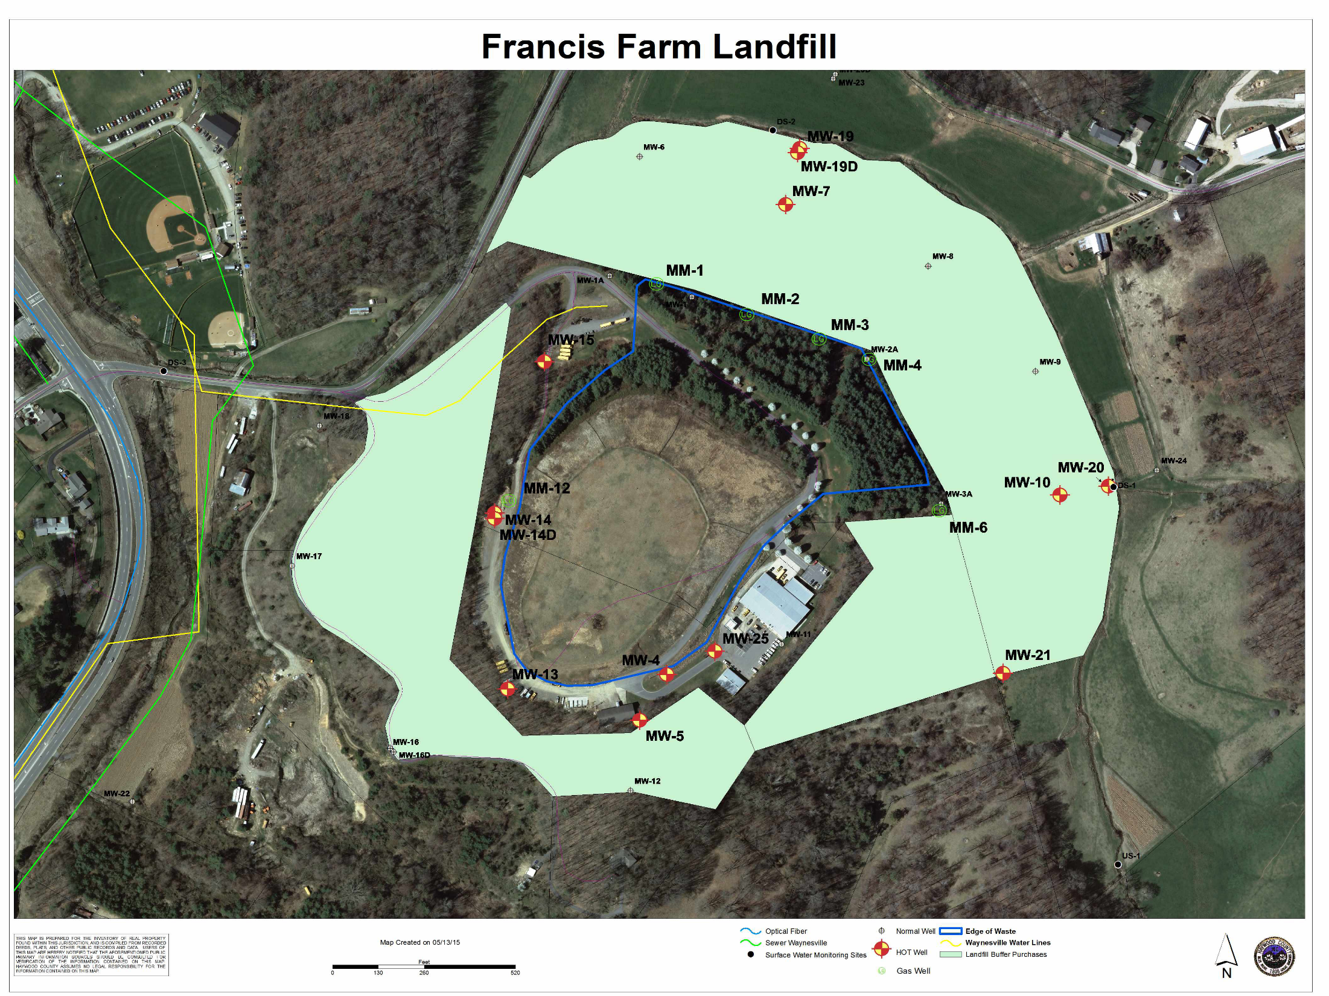

Slide 47
Buffer Purchases
Three surrounding properties were purchased in 2014 for $1,250,000
County avoided legal proceedings due to contamination of the properties by purchasing the surrounding properties creating a buffer as required by NCDENR

Slide 48
Buffer Purchases

Slide 49
What’s Next?
Begin Cap Maintenance of placing 43,000 cubic yards of dirt on top of landfill. 2015
Begin saving for Construction. 2015
Continue to develop Assessment of Corrective Measures to be approved by NCDENR. 2015-2016
Permit Modification and Construction Design 2016-2018
Begin Construction 2018-2019

Slide 50
2015 Solid Waste Budget
White Oak Landfill $ 530,300
Convenience Centers 840,363
Hauling 687,982
Materials Recovery Facility 1,555,100
Francis Farm Landfill 2,152,912
Contingency
Total $6,266,987
Recommended Availability Fee $164.00

Slide 51
SUMMARY OF RECOMMENDATIONS BY FUND
The recommended County of Haywood Fiscal Year 2015-2016 Budget for the General Fund is: $72,939,354
Special Revenue Fund – Emergency Telephone System (E-911) – $376,063;
Special Revenue Fund – Solid Waste - $6,266,987;
Special Revenue Fund – Road Districts – $184,603;
Special Revenue Fund – Fire Districts – $3,693,688;
Special Revenue Fund – Junaluska Sanitary District – $195,000;
Special Revenue Fund – Law Enforcement Officer Separation - $58,131;
Southwestern Child Development Center Fund – $3,000,000;
Internal Service Funds – $6,150,857

Slide 52
LARGER TICKET ITEMS
$3,320,296.06

Slide 53
HISTORIC TAX INCREASE

Slide 54
HAYWOOD COUNTY BUDGETS CPI INCREASE VS. ACTUAL BUDGETS
 |  |  | CPI January before budget year | Budgets using CPI inc./(dec) each year |  | Recommended Budgets | Actual Budget increases |  | Difference in CPI increasese and budgets
 | Jan 08 CPI | FY 2009 | 4.28% | $ 70,860,456 |  | $ 70,226,546 | 3.35% |  | $ 633,910
 | Jan 15 CPI | FY 2016 | -0.09% | $ 78,458,602 |  | $ 72,939,354 | 5.60% |  | $ 5,519,248
The FY 2009 budget was $70,226,546. This is the first budget over that budget since then, and if CPI January before budget year was applied and added to each budget, the budget would be $78,458,602. Our recommended budget is $72, 929,354.

Slide 55
Direction
May 21st at 5:00 p.m. Special Meeting -
Budget Public Hearing (public comment welcome)
June 1st at 9:00 a.m. (public comment welcome)
BOCC regular meeting with Work Session to follow
June 15th at 5:30 p.m. (public comment welcome)
Board of Commissioners’ Consideration for
Adoption of the Fiscal Year 15-16 Budget
Ordinance & Budget Document
Public input welcome and may be sent to :
email – comments@haywoodnc.net
Drop off or mailed to:
County Manager’s Office
215 N. Main St.
Waynesville, NC 28786
or call: 828-452-6625

