Slide 1
Question and Answer
Regional Recycling Solutions, LLC
November 2, 2015

Slide 2
Tax Incentives / Exemptions
Recycling Facilities are entitled to a local exemption of taxes on equipment, building and real property of the building per NCGS 105-275(8).
Regional Recycling Solutions (RRS) has agreed in an alternative offer to pay full market value of the property at $780,000 and will not receive any additional incentives from the County. RRS has now indicated they will ask for the exemption.

Slide 3
N.C. Department of Environmental Quality has documented a consistent increase in the number of our residents who work in the recycling industry. Recycling employment grew 5 percent during the recent recession and continues to grow, as evidenced by the record 17,000 private recycling jobs North Carolina now boasts.
http://www.newsobserver.com/opinion/letters-to-the-editor/article. Scott Mouw, Director of NC Recycyling

Slide 4
Beaverdam Industrial Park
County purchased 103 acres in July of 1993 from Greene Land Company
Elchin Inc purchases 40 acres in April 1998
Roltek purchases 3 acres in December 1998
County bought 16 additional acres in 1999
9 homes built adjacent to Beaverdam Industrial Park in Greene Mountain Estates from 2003-2006
Plus Cleaners purchases 6.16 acres in June 2005
2008 County grades 10 acres for building site

Slide 5
Question: How will the traffic impact Beaverdam Community?

Slide 6
NCDOT CAPACITY ESTIMATIONS

Slide 7
Traffic Concerns
50,000 vehicles travel I-40 daily by Exit 33. 50 vehicles is one tenth of 1% of vehicles of the average daily count
2400 vehicles uses Beaverdam Road daily. 50 vehicles is 2.08% of vehicles of the average daily count

Slide 8
Diesel Commercial Vehicles
Vehicles powered by an engine that meets or beats the model year 2010 standard has resulted in a reduction of 1.5 million tons of NOx between 2010 and 2014 while vehicles powered by engines that meet or beat the 2007 standard have reduce emissions of particulate matter by 40,000 tons since 2007.
For commercial vehicles, comprising everything from large pickups to even larger Class 8 tractors, the latest strict emissions standards established for model year 2007 and the stricter model year 2010 result in near zero emissions of particulate matter and oxides of nitrogen, an ozone forming compound.
Reducing the idling time of vehicles saves fuel and money, protects public health and the environment, and increases U.S. energy security. Reducing idle time can also reduce engine wear and associated maintenance costs.
Per: http://www.dieselforum.org/policy/meeting-clean-air-goals
Per: http://www.afdc.energy.gov/conserve/idle_reduction_benefits.html

Slide 9
Diesel Commercial Vehicles

Slide 10
Rough Creek Water Shed

Slide 11
Questions: Will the Rough Creek Watershed be affected?
Answer: No, there is 1.45 miles from the RCW to the BIP, which is 410 feet lower in elevation. Richard Wooten, Senior Geologist for Geohazards and Engineering Geology states, “ There is no reasonable way to conclude that runoff from the tract in Beaverdam Industrial Park would affect the tract in the Rough Creek watershed.”

Slide 12
Environmental Impact
Property will be prohibited by permit and by deed restriction from any type of incineration or gasification of waste
Property can not be permitted for any type of landfill operations

Slide 13
Question: What involvement has
Mr. Allison had in other counties?

Slide 14
Transylvania County
Transylvania Economic Director learns of project through the BioFuels Center of NC in April of 2011. The original project appears to turn wood chips into bio diesel.
Renewable Developers sought land in Transylvania. EDC directs them to the Transylvania Airport and the former Ecusta site. Ken Allison owns the airport site.
Renewable Developers sought to purchase airport site.
Over the next two years, the project goes to a waste incineration and diesel burning facility to place power back on the grid
Transylvania County enacts a moratorium –Bio-Mass Electricity Generating Facility Using a Pyrolysis Process and a Materials Recovery Facility and any Facility Using Municipal Solid Waste as a Feedstock-July 22, 2013

Slide 15
Town of Fletcher
Regional Recycling Solutions, LLC (RRS) formed by Ken Allison in May of 2014
RRS found a site in the Extra Territorial Jurisdiction of the Town of Fletcher
RRS met with town officials but decided not to pursue site due to limitations of building site. Town Manager stated they did not have any preliminary objections of the proposed enterprise

Slide 16
Buncombe County
RRS applied for a Conditional Use Permit to the Buncombe County Board of Adjustment in March 2015 for 53 acre tract on Pond Road
Application denied by Board, due to plans not approved by NCDENR on July 8, 2015
NCDENR will not approve without Buncombe County’s approval

Slide 17
Question: Will the waste from Regional Recycling Solutions (RRS) shorten the life of the Haywood County landfill?
Answer: No, waste from RRS will be taken to Tennessee.
Permit does not allow any out of state waste
Agreement in place that limits tonnage of waste

Slide 18
Question: Why did the Montgomery, Alabama recycling plant close?
Answer: Due to the decline in commodity pricing, not to the quality of the product.
The Mayor states that five or six companies have inquired the possibility of taking control of the facility
Montgomery Advertiser, October 5 & 23, 2015

Slide 19
Competitors
Pratt Industries stated they are not a competitor.
They have four plants within a three hour drive of Haywood County and a gasifying plant in their Conyers, Georgia facility to burn residual by-product from their production facility.
The other two recycling facilities in WNC do not operate with a bag breaker and do not have newer technologies

Slide 20
Regional Recycling Solutions
& Stadler have worked together to develop operational plan for the facility

Slide 21
STADLER® Anlagenbau GmbH is dedicated to the planning, production and assembly of sorting systems and components for the waste disposal and recycling industry world-wide

Slide 22
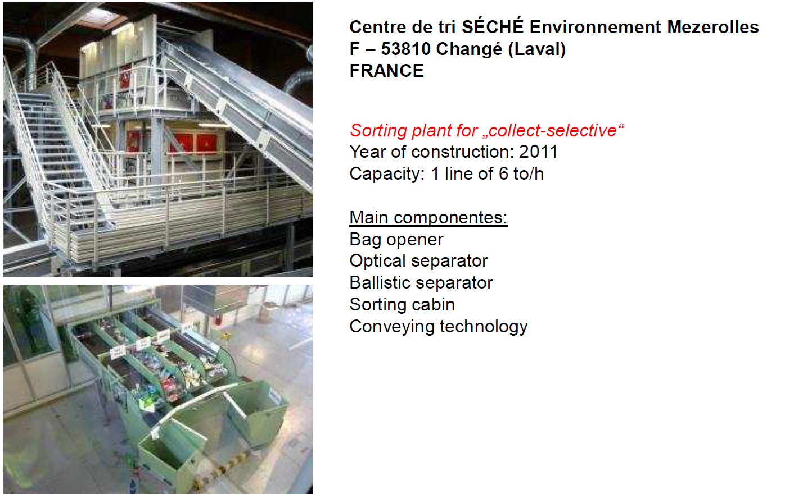
Stadler
Stadler has over 200 recycling and solid waste facilities in Europe

Slide 23
Stadler North America Sites

Slide 24
Regional Recycling Solutions
Question: What will be the standard operating hours?
Answer: 7am until 4pm
Answer provided by Regional Recycling Solutions

Slide 25
Regional Recycling Solutions
Question: Who will operate the facility?
Answer: RRS’ team has over 100 years in recycling and MRF management. The plant manager will be trained in Germany for two months. Stadler employees will be at the opening of facility for several weeks to train all personnel.
Answer provided by Regional Recycling Solutions

Slide 26
Regional Recycling Solutions
Question: Will local people from Haywood County be hired to work at RRS?
Answer: RRS anticipates about 90% of the workforce will be from Haywood County
Answer provided by Regional Recycling Solutions

Slide 27
Regional Recycling Solutions
Question: Why does this facility need a permit?
Answer: Since a limited amount of waste will come in to the facility, a permit is required by NCDEQ. Being permitted will give better oversite to the operations
Answer provided by Regional Recycling Solutions

Slide 28
Regional Recycling Solutions
Question: Where will the material that is unusable be transported to?
Answer: A landfill in Tennessee
Answer provided by Regional Recycling Solutions

Slide 29
Regional Recycling Solutions
Question: What processes will be going on in the different phases of the project?
Answer: All proposed facilities will be baling, separating commercial recyclables, processing single stream materials and opening bagged material
Answer provided by Regional Recycling Solutions

Slide 30
Question: Will there be more waste coming into Haywood County?
Answer: Yes, but the waste will be transported and shipped to TN
Answer provided by Regional Recycling Solutions

Slide 31
Regional Recycling Solutions
Question: How will the processing protect the paper and cardboard?
Answer: The two fiber (cardboard and mixed paper) grades will be sorted out separately by a mixture of machinery and manual sorters to provide the final quality control prior to baling and sell to market.
Answer provided by Regional Recycling Solutions and Stadler

Slide 32
STADLER®
Question: Please explain the safety of machines and operations at Stadler facilities?
Answer: STADLER’s equipment is engineering and manufactured keeping European and USA based safety regulations (OSHA and ANSI) in mind. Europe is ahead of the USA in terms of safety and health regulations when it comes to MRF to protect the person operating at these facilities. Components are design to meet the highest standard of safety for this matter. With a substantial footprint of operating plants from STADLER in the United Kingdom in place, are proof of Stadler’s safe equipment is one of the countries with the highest health and safety standards.
The heart of the STADLER system: The Ballistic separator is a much safer piece of equipment to maintain than it’s USA counter piece of equipment, the “disc Screens” to separate 2D from 3D. With minimum changes of wrapping, there is limited need for personnel to enter the equipment with box cutters to undo wrapped material than it’s counter part the disc screen. It’s working area inside the machine is at a much lower angle than the typical disc screens and there is risk to balance on rotating shafts.

Slide 33
STADLER®
Question: European model assumes there is an incineration at the end of the process. Is this a correct assumption?
Answer: First of all, ‘incineration’, is a negative verbiage to be used when referring to waste to energy. There is indeed a substantial waste to energy infrastructure in place in Europe, but the EU has mandates / regulation in place that require extensive sorting of valuable commodities. This sorting is either done by residents at the curb and at collection points through cities OR through MRF’s. Generally the final residue fraction from these MRF’s that have no to limited value are presented as an “engineered fuel” to existing waste to energy facilities or as an alternative fuel for existing Coal fired power plants or Cement plants. There will be no incineration at the Haywood County site

Slide 34
STADLER®
Question: Please explain the sorting technology that will make the materials marketable after the processing?
Answer: The valuable recyclable materials are already source separated by the residential and commercial accounts. This mixture of dry materials will be brought to the facility to be processed and separated by type and grade by an efficient sorting processing, consisting of proven technology and final manual quality control to ensure marketable product meeting today’s applicable market standards. Any residue from this process will be transferred off site to existing landfills.

Slide 35
STADLER®
Question: Is there a chance mercury light bulbs or other hazardous material can contaminate material and surrounding area, particular leaking through the floor?
Answer: Materials brought and processed at the facility pass various stages of visual inspection for any contamination that could harm the safety of the workers, the process and marketability of the commodities:
1) Visual inspection of the loads received from the trucks dumped on tipping floor
2) Grapple operator feeding material to the process has the ability to screen and remove any contamination

Slide 36
STADLER®
3) Manual sorters along the pre-sort conveyor have the ability to remove contamination, including hazardous materials
Although waste stream will be dry and heavily source separated, safety protocols will be in place to handle hazardous materials appropriately if they would make it to the facility. In case of hazardous materials found, RRS will work with the city or County to properly educate it’s residents.
Education to haulers and citizens will be a major emphasis of RRS.

Slide 37
STADLER®
Question: Did you design the Lawrence, Kansas facility? If so, how is it operating?
Answer: Yes, STADLER designed the Lawrence facility and our staff was instrumental to it’s final design and layout. The customer is very happy from an operational perspective with the equipment and its high operating up-time. One of the KEY reasons for this customer to select STADLER is for the safe maintainability of the Ballistic Separator and the minimum leakage points of the various transitions between conveyors and other equipment. This latter is keeping the working environment clean and avoids / minimizes tripping or slipping hazards

Slide 38
STADLER®
Question: Please confirm the number of people needed to operate the proposed facility here in Haywood County.
Answer: RRS is planning to employ 28 - 32 people to operate the Haywood county MRF. The labor skills applicable range from manual sorters on the sort line to office staff to support the daily operations.

