Slide 1
REGIONAL RECYCLING SOLUTIONS, LLC

Slide 2
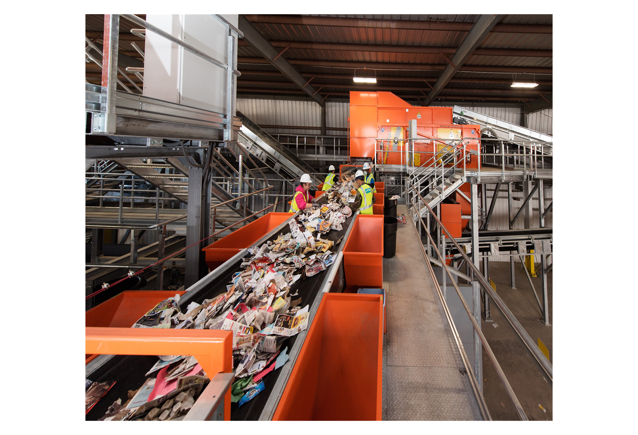
RRS is an American Company Bringing European Technology to Increase Recycling and Reduce Landfill Space Needs in WNC

Slide 3
Game Plan
RRS is a recycling company who has to handle some waste
Not a waste company handling some recycling
We can’t make a profit handling waste Because waste has a landfill tipping fee

Slide 4
Game Plan
Recyclables mixed with ordinary waste are of lesser quality
Goal is to have less than 20% of waste in the beginning and then less than 5% thereafter

Slide 5
Game Plan
RRS will not handle any hazardous or medical waste
All loads will be inspected for any non permitted items

Slide 6
Game Plan
RRS will never incinerate or landfill any material on site- Ever!

Slide 7
Game Plan
RRS primary target is commercial, industrial accounts and single stream recycling
Significant processing improvements over the current recycling options available in WNC

Slide 8
Game Plan
No other recycling company in WNC has a bag breaker
The most advanced technological recycling company in the Southeast

Slide 9
Game Plan
Process 25 tons of material an hour
Less than 3 trucks per hour

Slide 10
Phase I
$12 Million Dollar Investment of Infrastructure and Development Cost
20 Employees in Production $28,900*
7 Employees in Administrative $30,000*
3 Employees in Logistics $38,000*
* Average Salary. Employees will have Benefits

Slide 11
Phase I Building

Slide 12
Phase I Building
Building will be totally enclosed
Moved entrance to east side of property away from subdivision
Will place heavy landscaping to block view from subdivision

Slide 13
Buildings
Will be built with odor controlling systems by ECOLO to alleviate residents concerns
Will be built with noise damping materials which meets or exceeds OSHA standards

Slide 14
Phase I Building

Slide 15
Regional Recycling Solutions

Slide 16
Regional Recycling Solutions

Slide 17
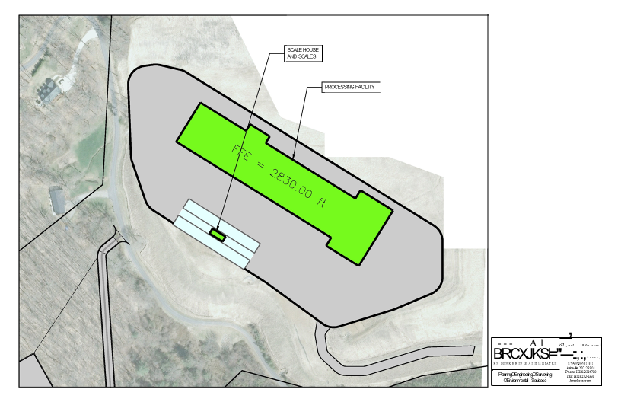
Proposed Phase I Site Plan

Slide 18
Education Center

Slide 19
Phases II & III
Phase II
$8 Million Dollar Additional Infrastructure
21 Additional Employees
Phase III
$4.8 Million Dollar Additional Infrastructure
20 Additional Employees

Slide 20
Regional Recycling Solutions

Slide 21
Regional Recycling Solutions
Future plans to open 12 other facilities in North America
Would like to locate Corporate Headquarters in Haywood County

