Slide 1
Party Disloyalty Defendants: 1. Mr. Arnold Edward Cabe 2. Mr. Jeremy Blaine Davis 3. Mr. Monroe A. Miller, Jr. 4. Mr. Richard Owen West 5. Mr. Paul David Yeager

Slide 2
Introduction: Party Disloyalty
From time to time, the General Counsel’s office is charged with prosecuting an action referred to the members of this State Executive Committee. In some instances the General Counsel’s office is charged with prosecuting Party Disloyalty, defined as:
Any registered Republican attempting to influence or influencing the outcome of any election against a Republican candidate or Republican endorsed by the appropriate Republican Executive Committee or Legislative Caucus, other than by supporting an opposing Republican Candidate in a Republican primary…
A charge of Party Disloyalty may be brought before the State Executive Committee by fifty members of the State Executive Committee, or by resolution of either a County or District Executive Committee. In this instance, your State Party has received two resolutions concerning the same five individuals. These resolutions come from the Haywood County Executive Committee, and the Eleventh Congressional District Executive Committee.

Slide 3
Introduction, Cont.
The Executive Committee must determine for each person charged, whether they committed Party Disloyalty as defined by the 2017 State Plan of Organization. If you find it more likely than not that an individual committed party disloyalty by a two-thirds (2/3) vote, you may then consider the sanction to be imposed. The only sanction available to you, regardless of the seriousness of the wrongful act, is to declare the person ineligible to serve in any office under the Plan of Organization for a period of not less than six (6) months and not more than five (5) years.
This matter must be handled in the strictest confidence. You are not to discuss the matter with anyone who is not a member of the State Executive Committee, or to disclose any of these materials. After the Executive Committee completes its work, it will make a public statement as to the outcome of this proceeding through the Chairman or the Executive Director.

Slide 4
Introduction, Cont.
What follows are some of the documents which indicate the substance of the charges, as well as additional matters concerning the conduct of these persons which may weigh on consideration of the penalty, if any, the State Executive Committee wishes to impose.
You will be provided with a copy of some of the materials which will be presented, so that you may familiarize yourself with them as they are presented to this Committee. Thank you for your attention to this important task.

Slide 5
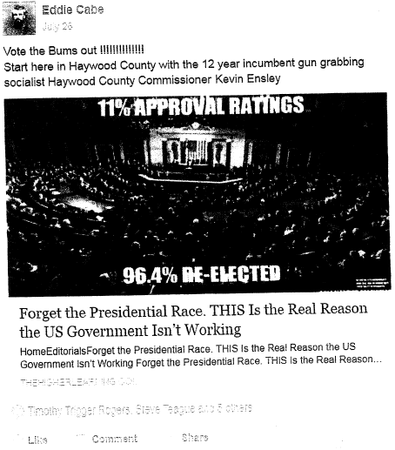
Mr. Arnold Edward Cabe:
Attempts to influence the outcome of Haywood County Commissioner election against a Republican candidate

Slide 6
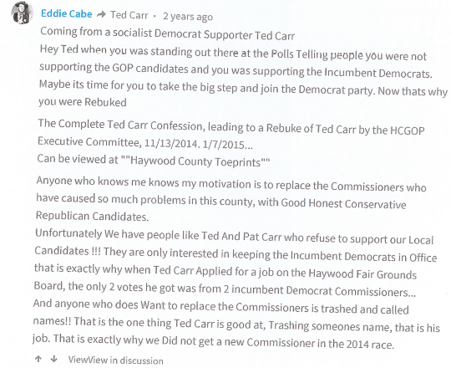

Slide 8
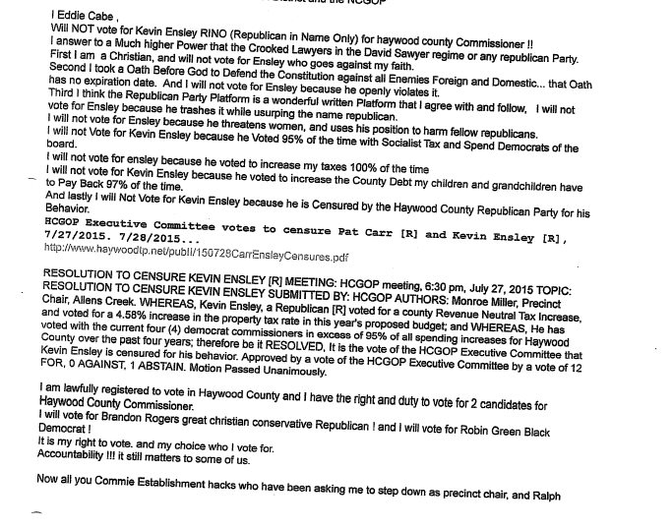

Slide 9
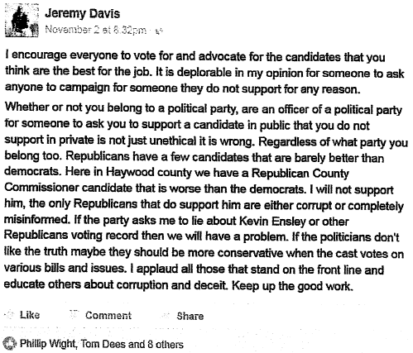
Mr. Jeremy Blaine Davis:
Attempts to influence the outcome of Haywood County Commissioner election against a Republican candidate

Slide 10
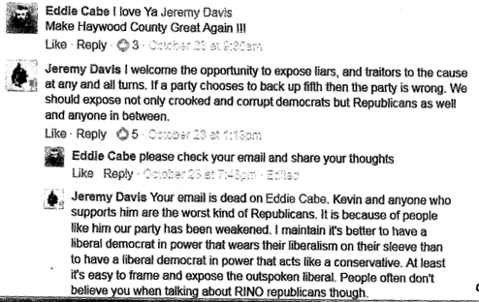

Slide 11
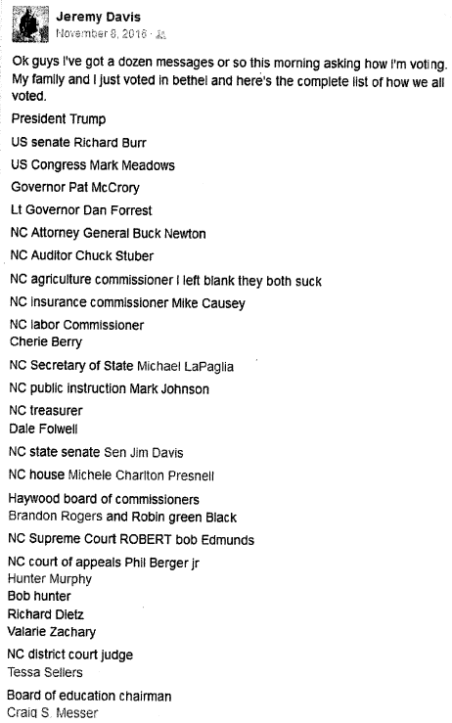

Slide 12
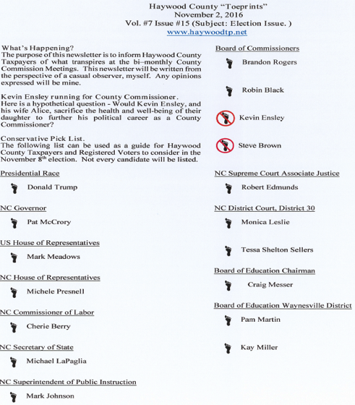
MR. Monroe A. Miller:
Attempts to influence the outcome of Haywood County Commissioner election against a Republican candidate

Slide 13
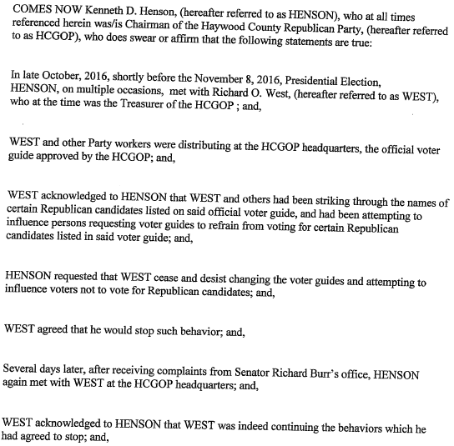
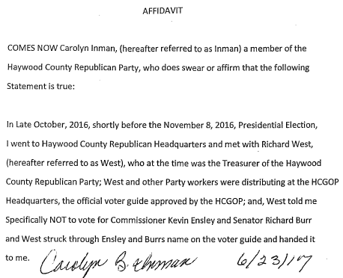
Mr. Richard Owen West:
Attempts to influence the outcome of Haywood County Commissioner election against a Republican candidate

Slide 14
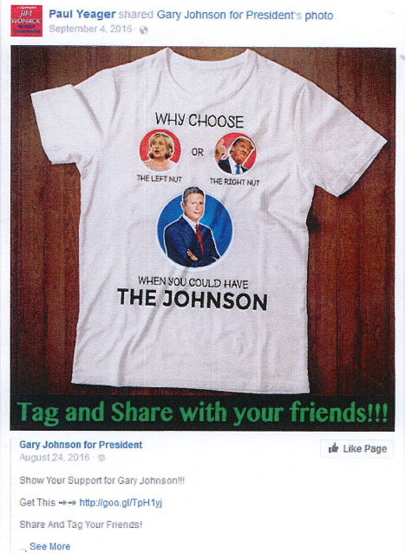
Mr. Paul David Yeager:
Attempts to influence the outcome of the US Presidential election against a Republican candidate

Slide 15
Conclusion:
Arnold Edward Cabe, Jeremy Blaine Davis, Monroe A Miller Jr., Richard Owen West and Paul David Yeager, all registered Republicans, have attempted to influence the outcome of the election for Haywood County Commissioner against Republican candidates, and have in some cases suggested supporting Democratic Party candidates. This behavior is in clear violation of the 2017 State Plan of Organization:
Any registered Republican attempting to influence or influencing the outcome of any election against a Republican candidate or Republican endorsed by the appropriate Republican Executive Committee or Legislative Caucus, other than by supporting an opposing Republican Candidate in a Republican primary…
It is your duty as members of the State Executive Committee to charge the offenders with violation of the foregoing provision. Should you do so by a two-thirds (2/3) vote, you may then consider a sanction for each offender which would render them ineligible to serve in any office under the Plan of Organization for a period of between six (6) months and five (5) years

